Slide 1
텐서플로와 머신러닝으로 시작하는 자연어처리
Lecture 1

Slide 2
강사 소개
조중현
중앙대학교 수학과
텐서플로와 머신러닝으로 시작하는 자연어 처리 집필
Creating A Neural Pedagogical Agent by Jointly Learning to Review and Assess 등 논문 저
AI blog “reniew’s blog” 운영
현) Riiid AI Researcher

Slide 4
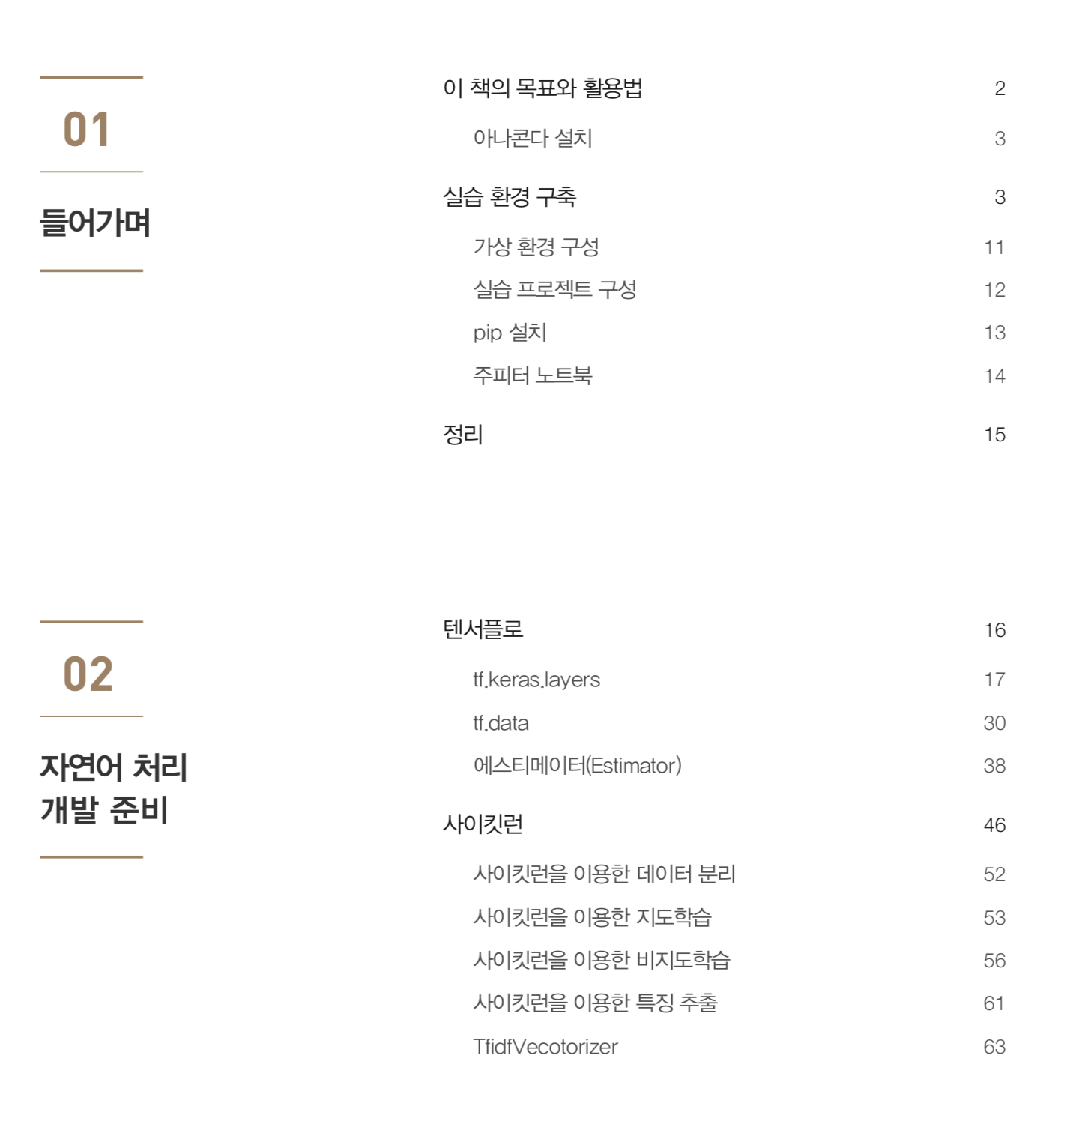

Slide 5
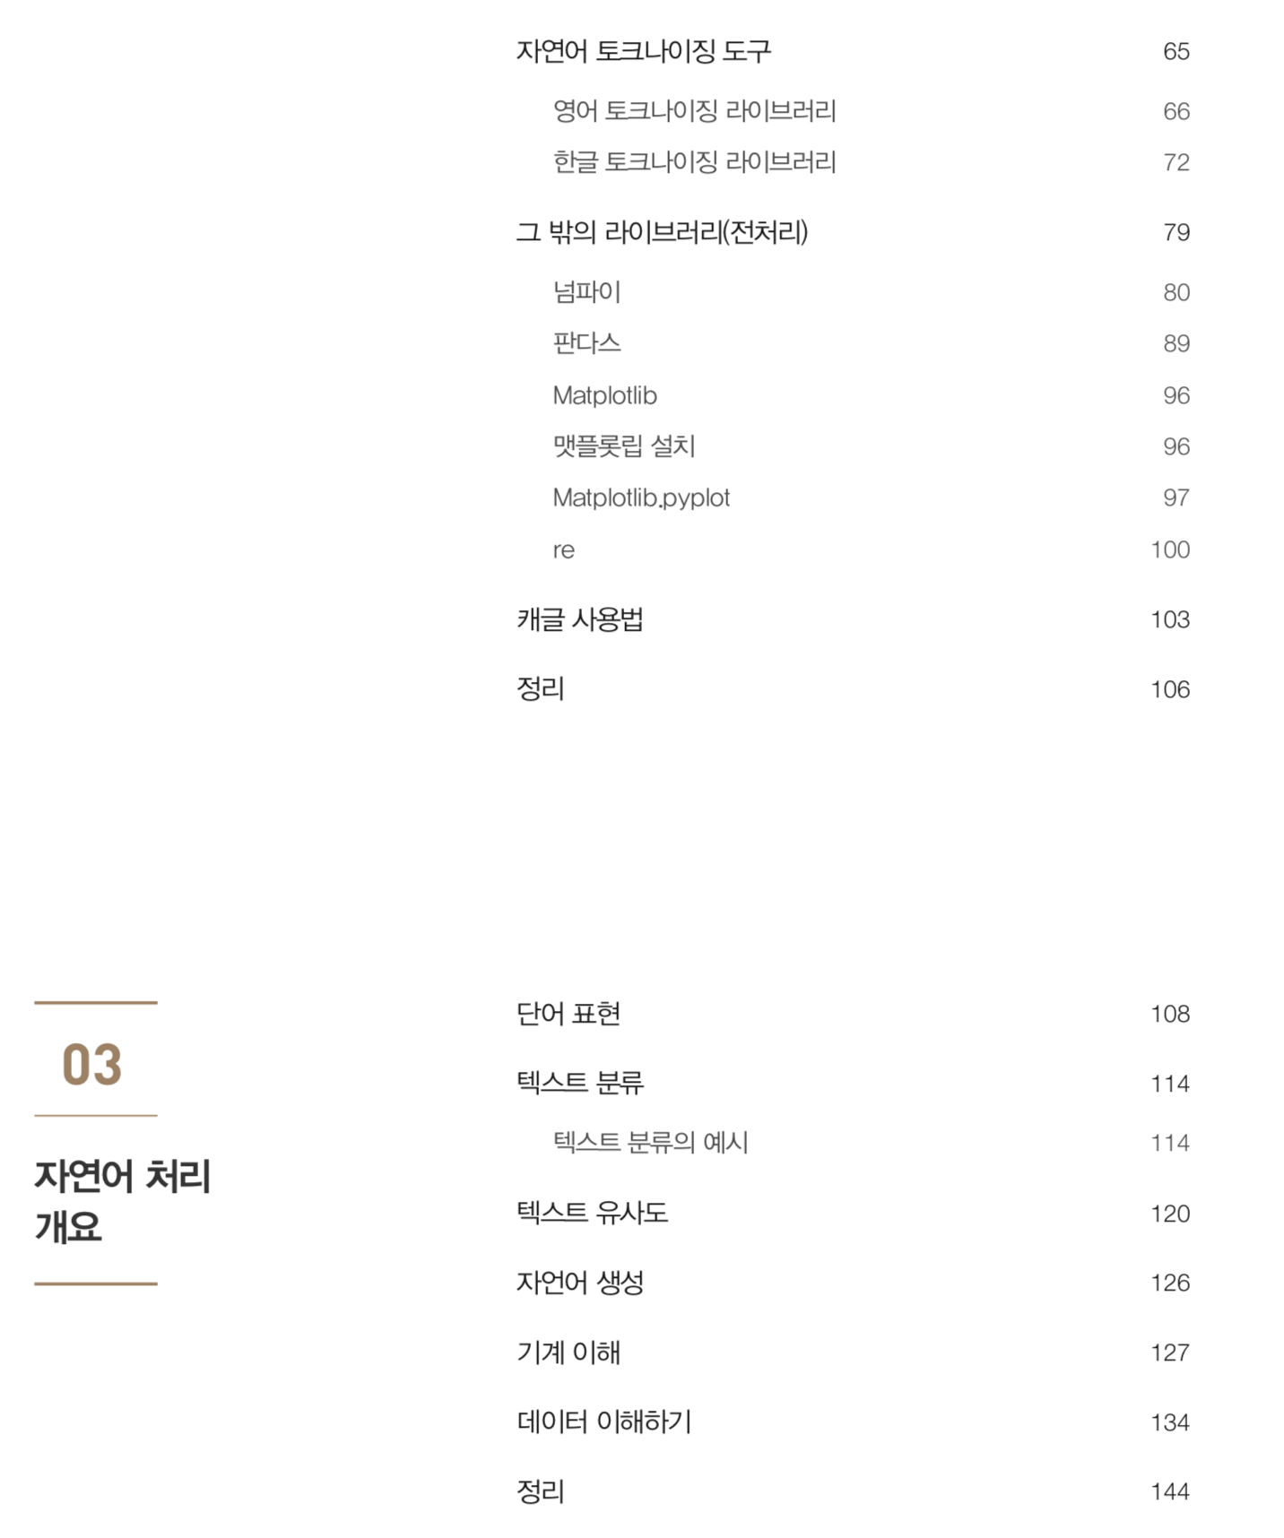

Slide 6
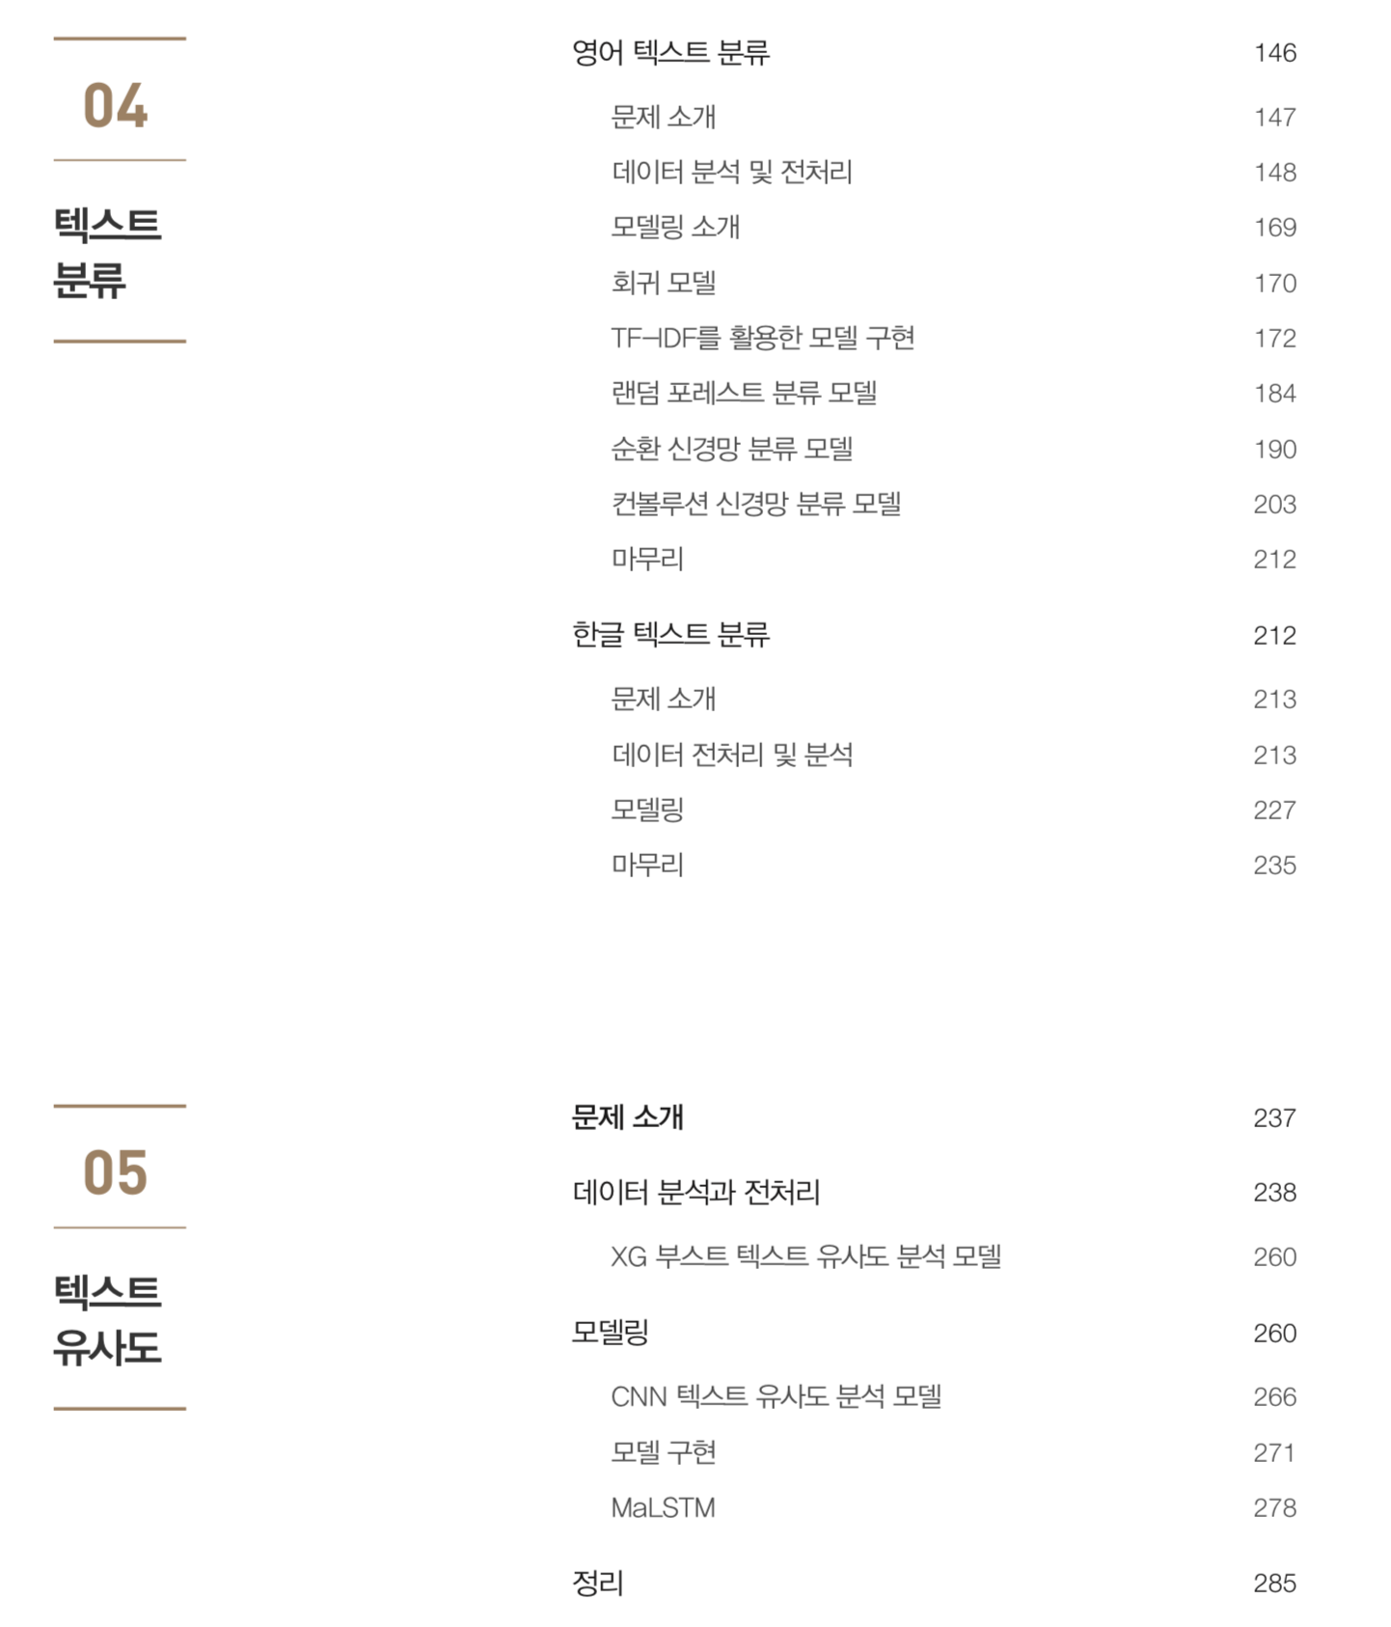

Slide 7
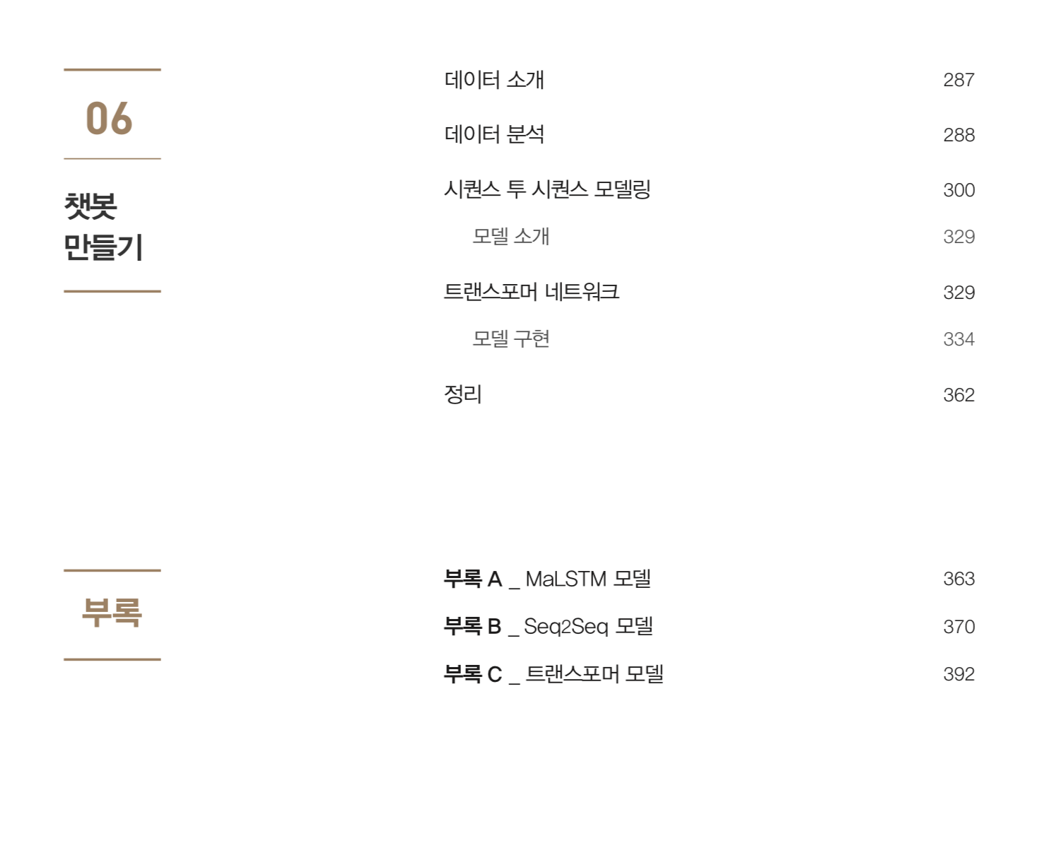

Slide 8
What do we learn?

Slide 9
What do we learn?
Basic TensorFlow
Word Representation
Text Classification
Text Similarity
Text Generation / Machine Translation

Slide 10
What do we learn?
Basic TensorFlow – 1주차
Word Representation – 2주차
Text Classification – 3주차
Text Similarity – 4 주차
Text Generation / Machine Translation – 5 - 8 주차

Slide 11
What do we learn?
Basic TensorFlow
Traditional TensorFlow implementation
Estimator vs Session
tf.data vs Placeholder & feed_dict
TensorFlow modules
TensorFlow 2.0

Slide 12
What do we learn?
Word Representation
Data format
Tabular data
Image data
Text data
One - hot
Bag of Words
Neural Text Representation
Word2Vec
GloVe
FastText

Slide 13
What do we learn?
Text Classification
What is Text Classification?
Why do we need Text Classification?
Text Classification Dataset
How do we evaluate Text Classification Model?
How does Text Classification work?
Classification Papers
Convolutional neural networks for sentence classification
Character-level Convolutional Networks for Text Classification

Slide 14
What do we learn?
Text Similarity
What is Text Similarity?
Why do we need Text Similarity?
Similarity 측정
Measuring Similarity by Classification
Natural Language Inference
Natural Language Inference Dataset
Similarity Algorithm
Ma-LSTM(Paper)
XG-Boost

Slide 15
What do we learn?
Text Generation / Machine Translation
What is Text Generation
What is Neural Machine Translation
Papers
Sequence to Sequence
Neural Machine Translation by Jointly Learning to Align and Translate
Attention is All You Need
How do we evaluate?
Neural Machine Translation Dataset
What is Attention Mechanism
Why do we need Attention
Various Attention Mechanism
Another methods to enrich NMT performance
Transformer
BERT + ….

Slide 16
Why do we learn?

Slide 17
Why do we learn?
ex) 커리어 전환, 실무에서의 자연어 처리 활용 ….

Slide 18
Basic TensorFlow

Slide 19
Basic TensorFlow
Traditional TensorFlow implementation
Estimator vs Session
tf.data vs Placeholder & feed_dict
TensorFlow modules
TensorFlow 2.0

Slide 20

TensorFlow
Graphs and Sessions

Slide 21
TensorFlow
TensorFlow는 (1) 연산(Operation)을 정의하는 것과
(2) 정의한 연산을 실행하는 부분이 분리되어 있다.

Slide 22
TensorFlow
TensorFlow는 (1) 연산(Operation)을 정의하는 것과
(2) 정의한 연산을 실행하는 부분이 분리되어 있다.
Graph
Session

Slide 23
TensorFlow
TensorFlow는 (1) 연산(Operation)을 정의하는 것과
(2) 정의한 연산을 실행하는 부분이 분리되어 있다.
Graph
Session
Not in eager execution!

Slide 24
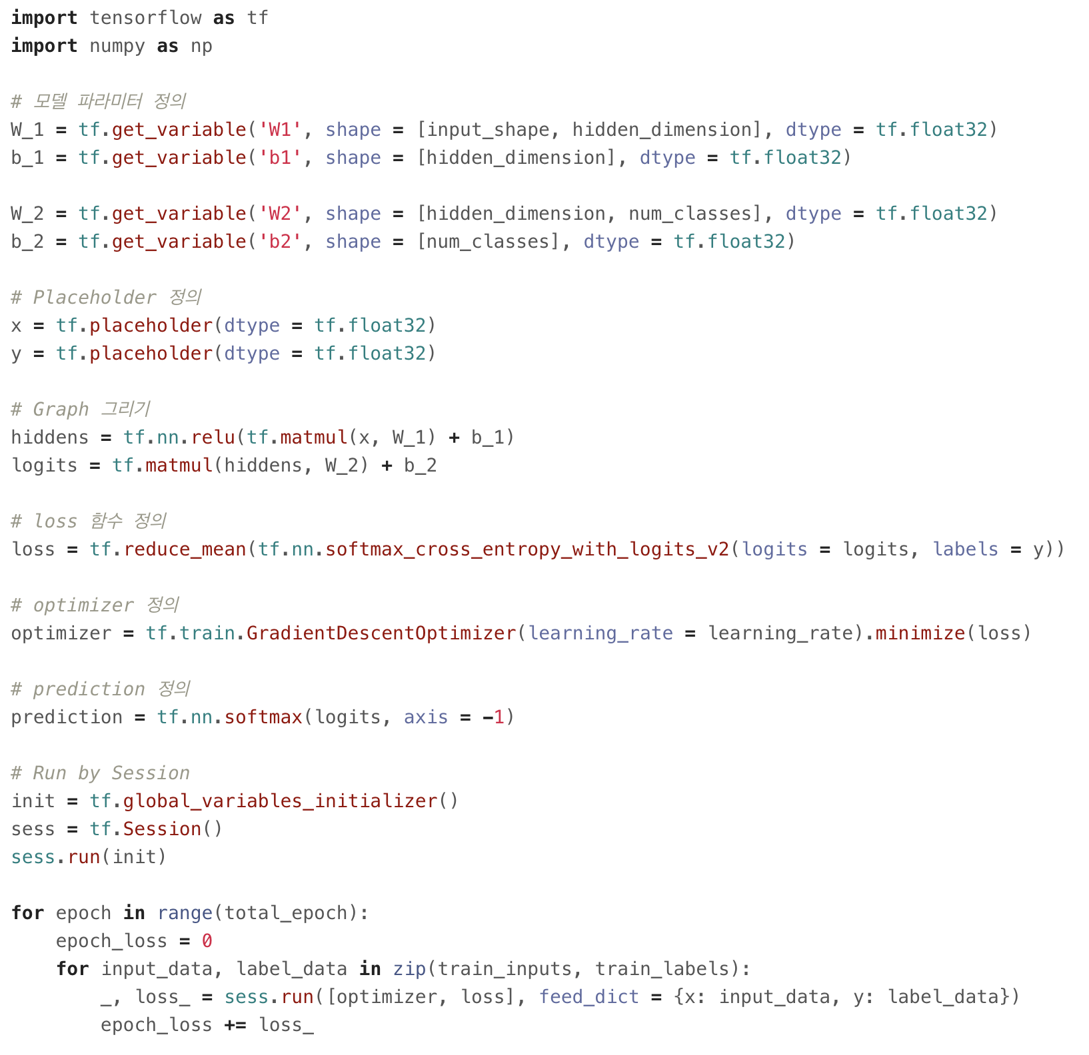
TensorFlow
Define operation

Slide 25
TensorFlow
Define operation
Execute operation by Session

Slide 26
TensorFlow

Slide 27
TensorFlow
모델 파라미터 정의

Slide 28
TensorFlow
Placeholder 정의

Slide 29
TensorFlow
Graph 그리기

Slide 30
TensorFlow
Loss, Optimizer, Prediction 정의

Slide 31
TensorFlow
Run Training by Session

Slide 32
TensorFlow
그 외 학습, 검증, 예측, 배포를 위해서 추가로 구현 필요.

Slide 33
Estimator

Slide 34
Estimator
“TensorFlow’s high-level machine learning API (tf.estimator) makes it easy to configure, train, and evaluate a variety of machine learning models”

Slide 35
Estimator
“TensorFlow’s high-level machine learning API (tf.estimator) makes it easy to configure, train, and evaluate a variety of machine learning models”
https://torres.ai

Slide 36
Estimator
Estimator 의 장점
High-Level API를 통해 간단하게 모델을 구현할 수 있다.
개발, 연구자들 사이에서 모델을 간단하게 공유할 수 있다.
Model을 변경할 필요 없이 CPU, GPU, TPU에서 실행 할 수 있다.
아래의 기능을 직접 구현할 필요없이 사용 할 수 있다.
Build Graph
Train / Evaluate / Predict
배포(export)
Variable 초기화
Data 불러오기
Checkpoint 파일을 만들기
TensorBoard를 사용하기 위한 Summaries를 저장

Slide 37
Estimator
Pre-made Estimator
Custom Estimator

Slide 38
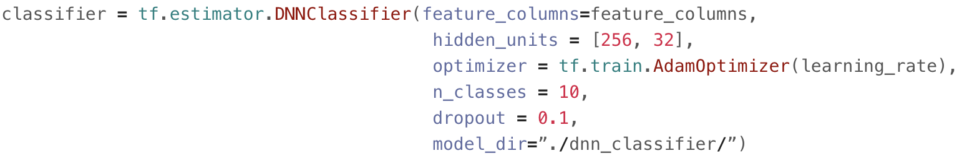
Estimator
Pre-made Estimator

Slide 39
Estimator
Pre-made Estimator
https://hackernoon.com/

Slide 40
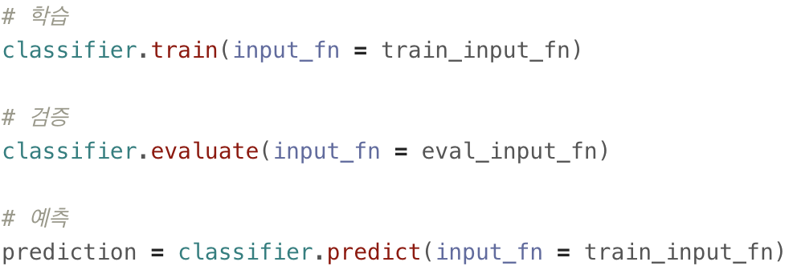
Estimator
Pre-made Estimator

Slide 41
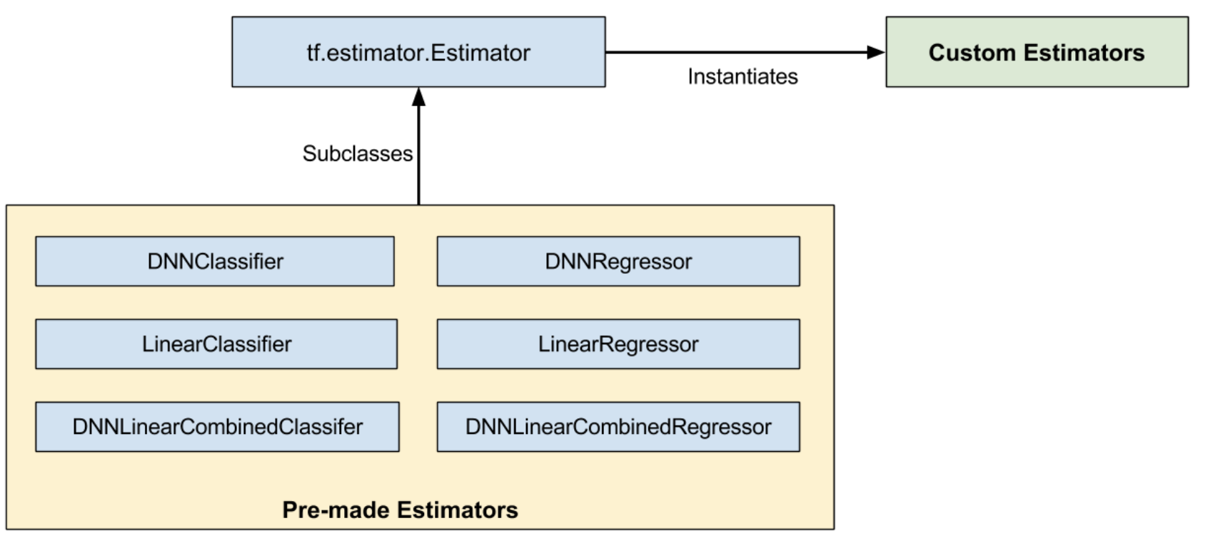
Estimator
Custom Estimator
https://www.tensorflow.com

Slide 42
Estimator
Custom Estimator
Define Input function
Define Model function
Instantiate Estimator

Slide 43
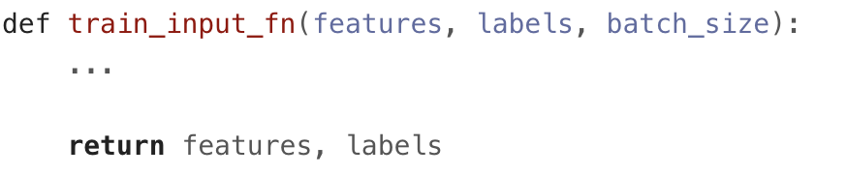
Estimator
Custom Estimator (define input function)

Slide 44
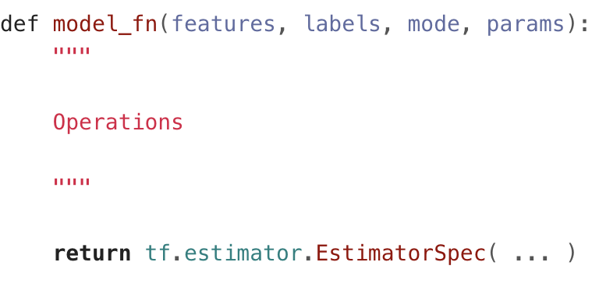
Estimator
Custom Estimator (define model function)

Slide 45
Estimator
Custom Estimator (define model function)
features: 모델의 입력값들의 dictionary
labels: 모델의 라벨
mode: 현재 모델 함수가 실행된 상태(train/evaluate/predict)
params: (Optional) 모델에 필요한 추가적인 하이퍼 파라미터

Slide 46
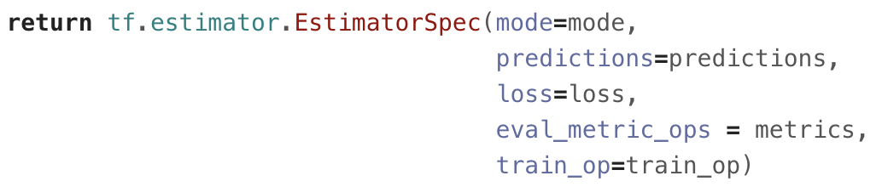
Estimator
Custom Estimator (define model function)

Slide 47
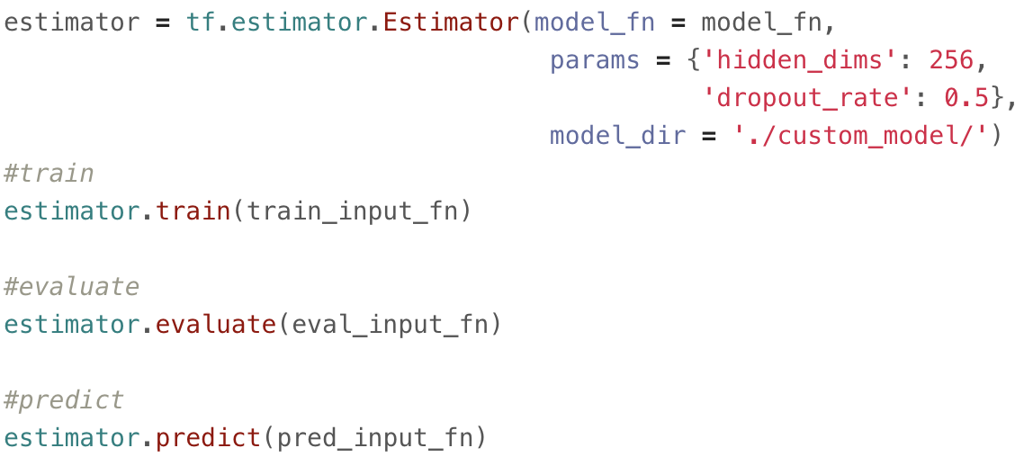
Estimator
Custom Estimator (instantiate Estimator)

Slide 48
Estimator
Custom Estimator (instantiate Estimator)

Slide 49
tf.data

Slide 50
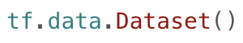
tf.data
TensorFlow Dataset API

Slide 51
tf.data
Advantage of Dataset API
기존의 placeholder & feed_dict 방법보다 높은 성능 (속도 측면)
간단한 batch, epoch, shuffle, map 구현
tf.estimator 와 같이 사용하기에 적합

Slide 52
tf.data
Advantage of Dataset API
기존의 placeholder & feed_dict 방법보다 높은 성능 (속도 측면)
간단한 batch, epoch, shuffle, map 구현
tf.estimator 와 같이 사용하기에 적합
Existing Data
Pipeline
Optimized Pipeline
with tf.data

Slide 53
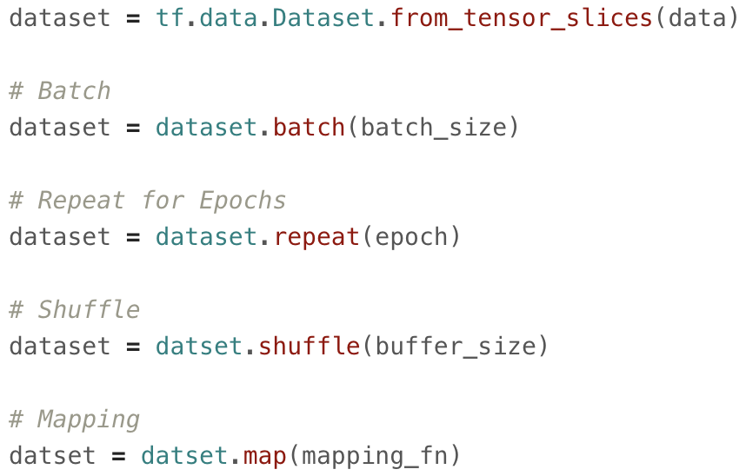
tf.data
Advantage of Dataset API
기존의 placeholder & feed_dict 방법보다 높은 성능 (속도 측면)
간단한 batch, epoch, shuffle, map 구현
tf.estimator 와 같이 사용하기에 적합

Slide 54
tf.data
Advantage of Dataset API
기존의 placeholder & feed_dict 방법보다 높은 성능 (속도 측면)
간단한 batch, epoch, shuffle, map 구현
tf.estimator 와 같이 사용하기에 적합

Slide 55
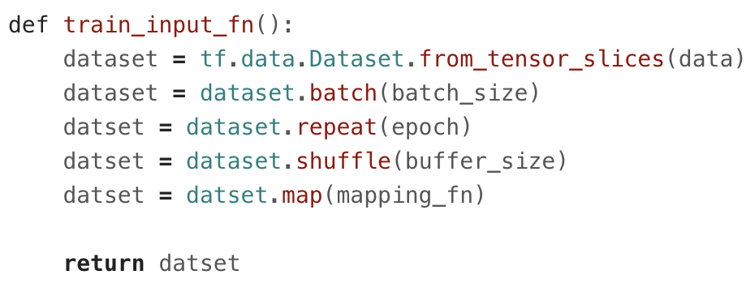
tf.data
Advantage of Dataset API
기존의 placeholder & feed_dict 방법보다 높은 성능 (속도 측면)
간단한 batch, epoch, shuffle, map 구현
tf.estimator 와 같이 사용하기에 적합

Slide 56
TensorFlow Modules

Slide 57
TensorFlow Modules
https://hackernoon.com/

Slide 58
TensorFlow Modules
https://hackernoon.com/

Slide 59
TensorFlow Modules
https://hackernoon.com/

Slide 60



TensorFlow Modules

Slide 61
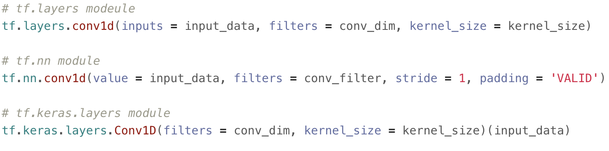
TensorFlow Modules

Slide 62
TensorFlow Modules
TensorFlow 2.0 에서는 대부분 tf.kears.layers 모듈로 통합

Slide 63
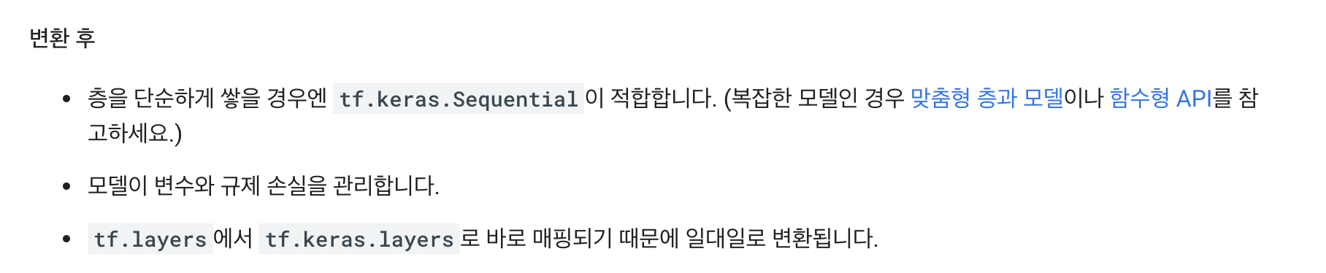
TensorFlow Modules
https://www.tensorflow.org/alpha/guide/migration_guide

Slide 64
TensorFlow Modules
https://www.tensorflow.org/alpha/guide/migration_guide

Slide 65
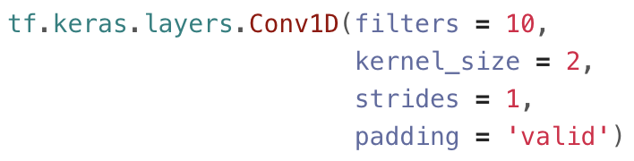
TensorFlow Modules
1. tf.keras.layers.Conv1D

Slide 66
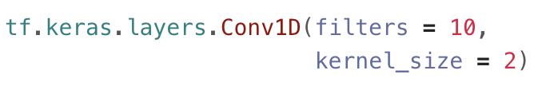
TensorFlow Modules
1. tf.keras.layers.Conv1D

Slide 67
TensorFlow Modules
1. tf.keras.layers.Conv1D

Slide 68
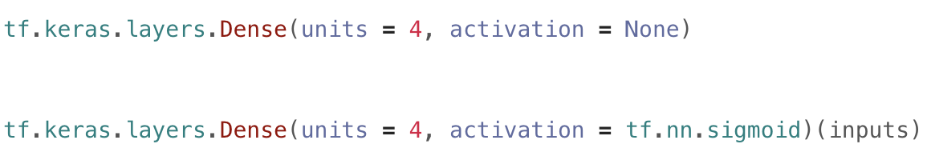
TensorFlow Modules
2. tf.keras.layers.Dense
https://hackernoon.com/

Slide 69
TensorFlow Modules
2. tf.keras.layers.Dense
https://hackernoon.com/

Slide 70
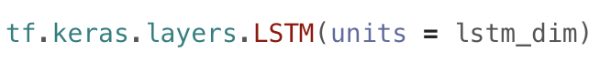
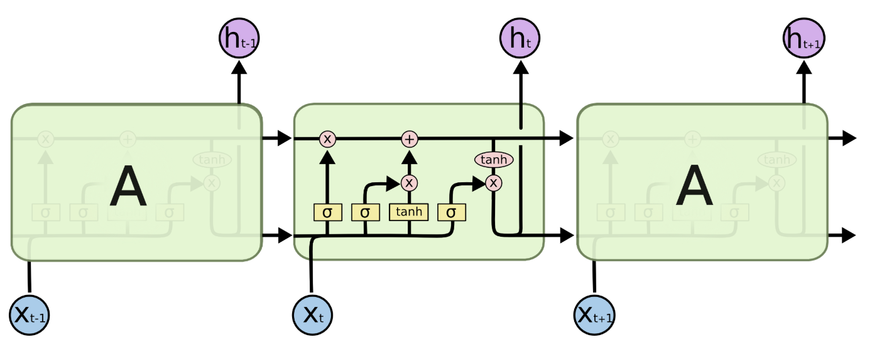
TensorFlow Modules
3. tf.keras.layers.LSTM
http://colah.github.io/

Slide 71
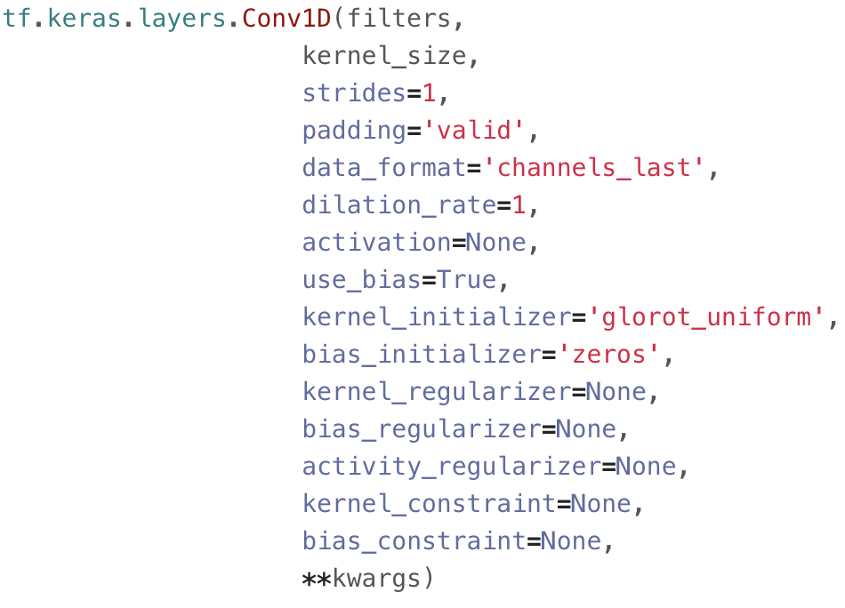
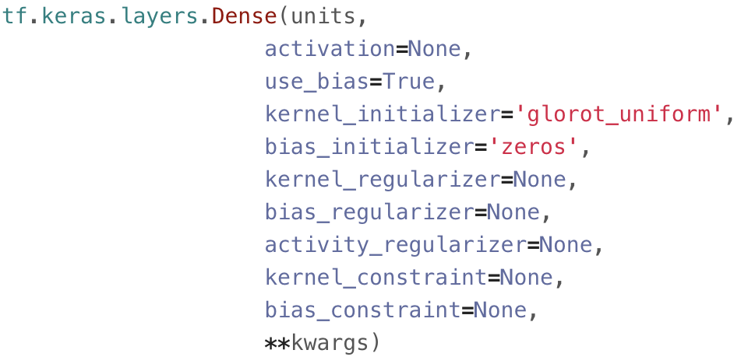
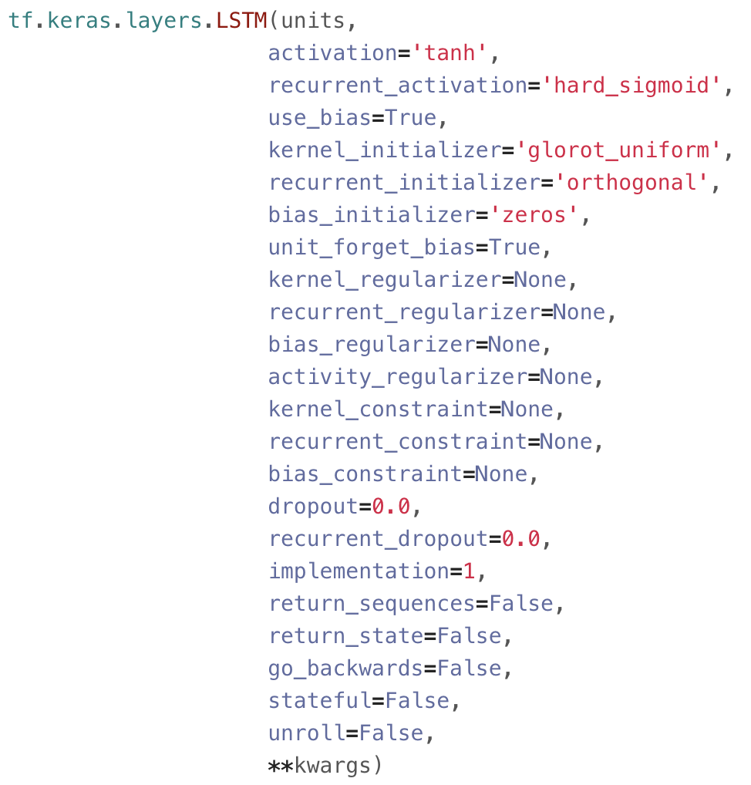
TensorFlow Modules
More Arguments

Slide 72
Traditional => Our style implementation

Slide 73
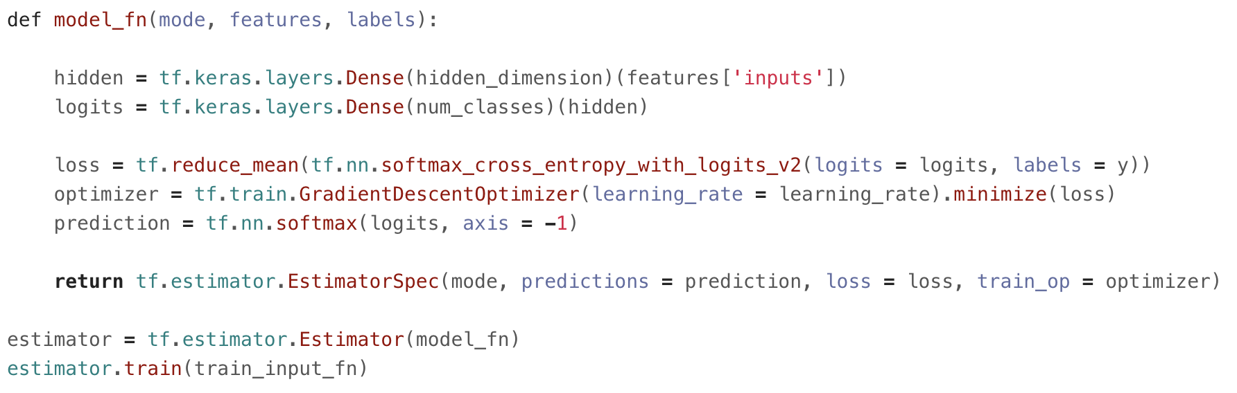
Traditional => Our style implementation

Slide 74
Traditional => Our style implementation
Using TensorFlow Module

Slide 75
Traditional => Our style implementation
Using TensorFlow Module

Slide 76
Traditional => Our style implementation
Using Estimator, tf.data

Slide 77
Traditional => Our style implementation
Using Estimator, tf.data

Slide 78
TensorFlow 2.0

Slide 79
TensorFlow 2.0
A brief summary of major changes
API Cleanup
Eager execution
No more globals
Functions, not sessions
AutoGraph
Keras Python API

Slide 80
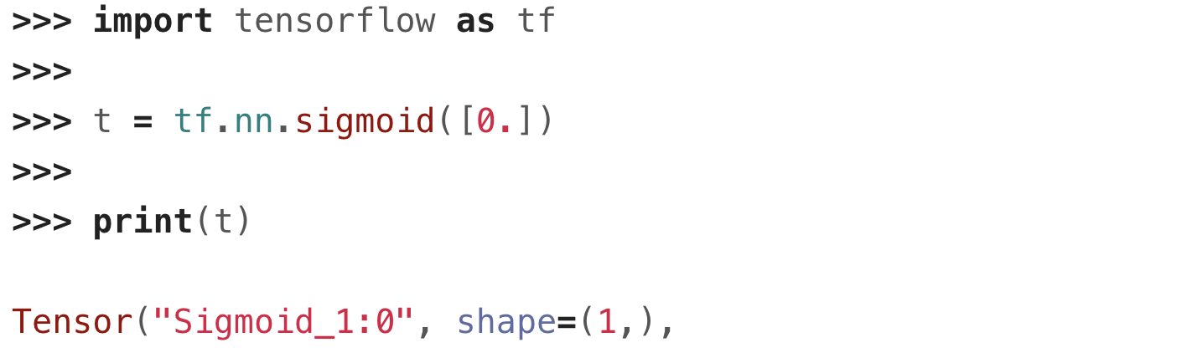
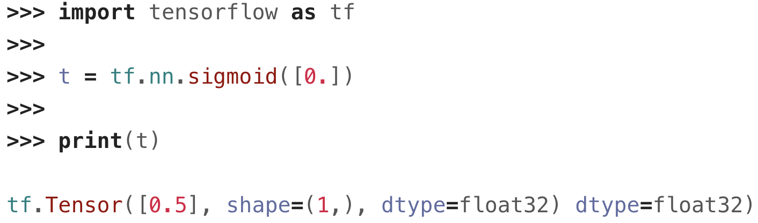
Eager Execution
TensorFlow 1.X
TensorFlow 2.0

Slide 81
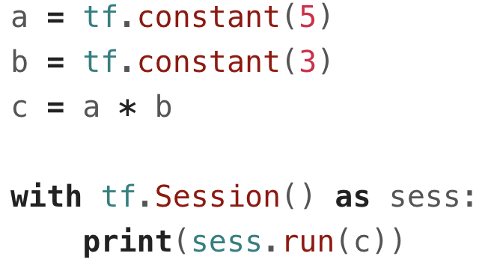
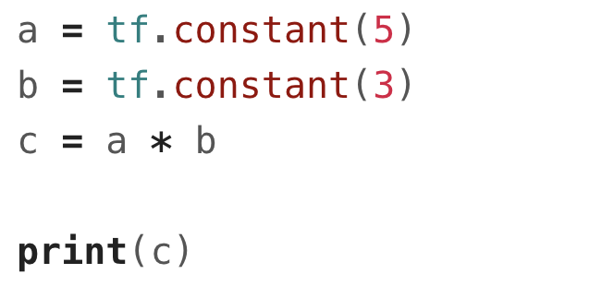
Functions, not Session
TensorFlow 1.X
TensorFlow 2.0

Slide 82
TensorFlow 2.0 Concept Diagram
https://medium.com/tensorflow/tensorflow-2-0-is-now-available-57d706c2a9ab

Slide 83
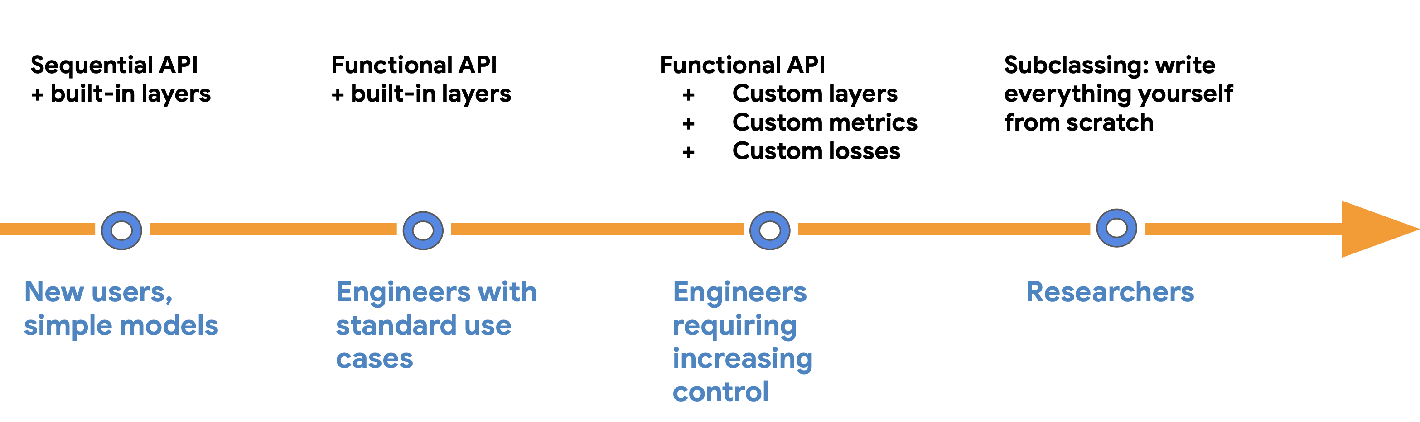
Model Building
Progressive disclosure of complexity

Slide 84
Model Building
Progressive disclosure of complexity

Slide 85
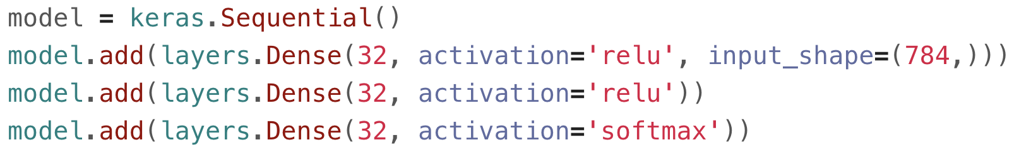
Model Building
Sequential API + built-in layers

Slide 86
Model Building
Progressive disclosure of complexity

Slide 87
Model Building
Progressive disclosure of complexity

Slide 88
Model Building
Functional API + built-in layers

Slide 89
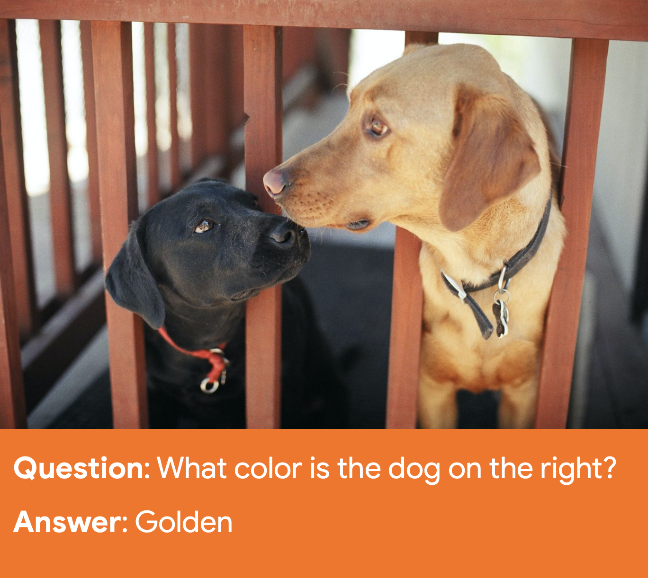
Model Building
Functional API + built-in layers
Visual Question Answering
https://www.flickr.com/photos/cogdog/3296940

Slide 90
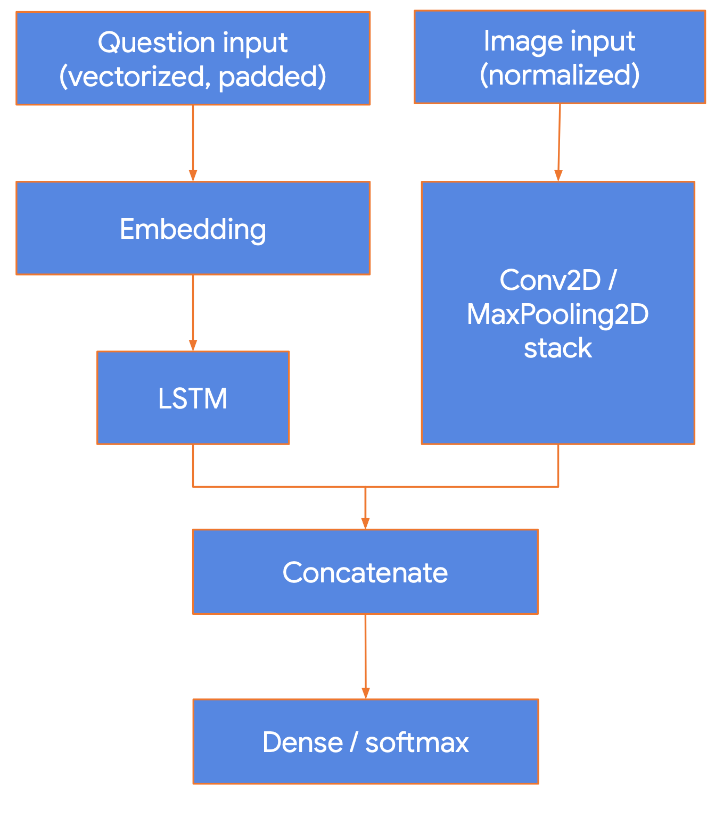
Model Building
Functional API + built-in layers

Slide 91
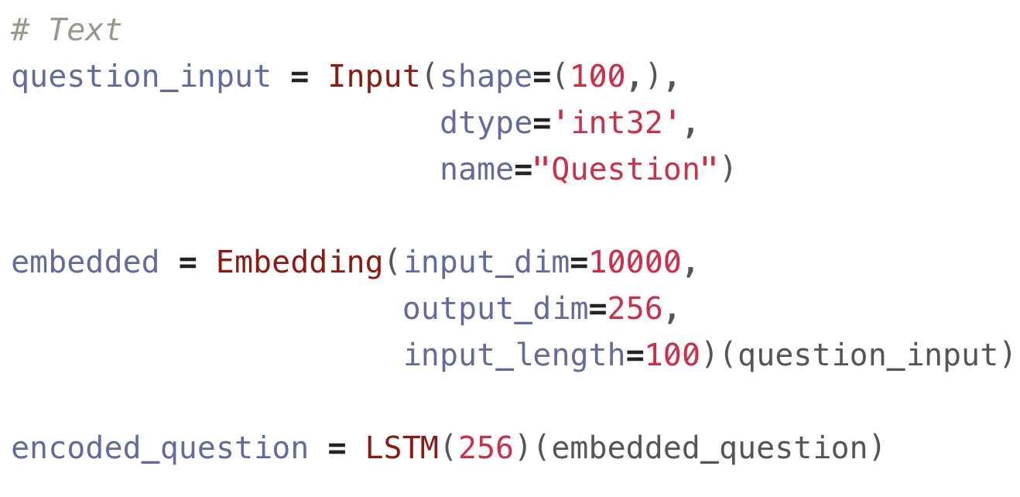
Model Building
Functional API + built-in layers

Slide 92
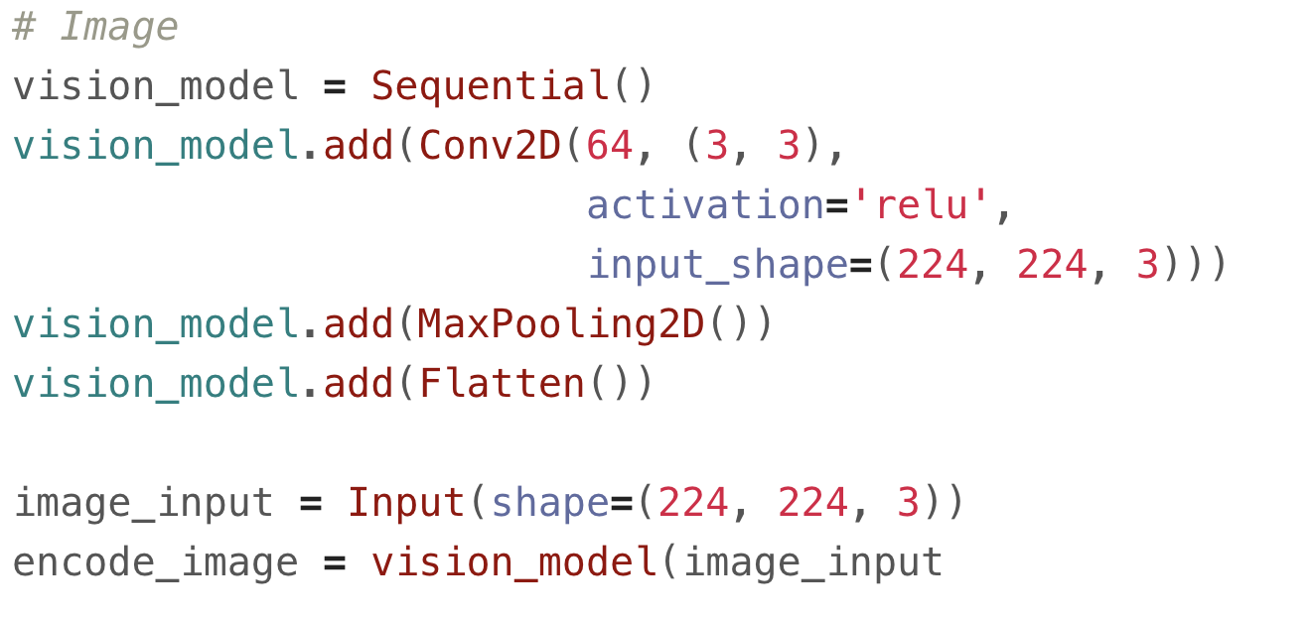
Model Building
Functional API + built-in layers

Slide 93
Model Building
Functional API + built-in layers

Slide 94
Model Building
Progressive disclosure of complexity

Slide 95
Model Building
Progressive disclosure of complexity

Slide 96
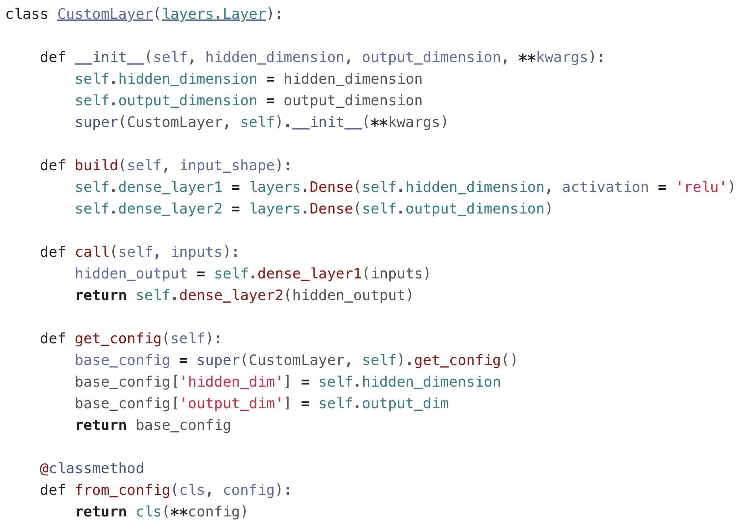
Model Building
Custom Layer

Slide 97
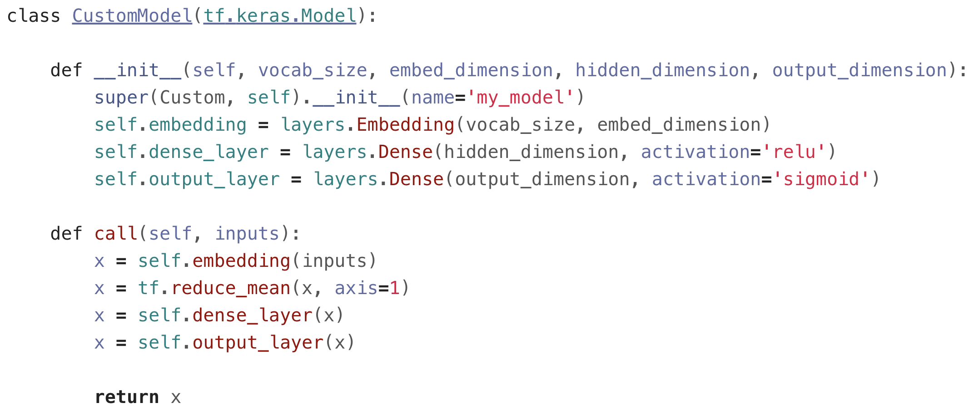
Model Building
Custom Model

Slide 98
Model Training

Slide 99
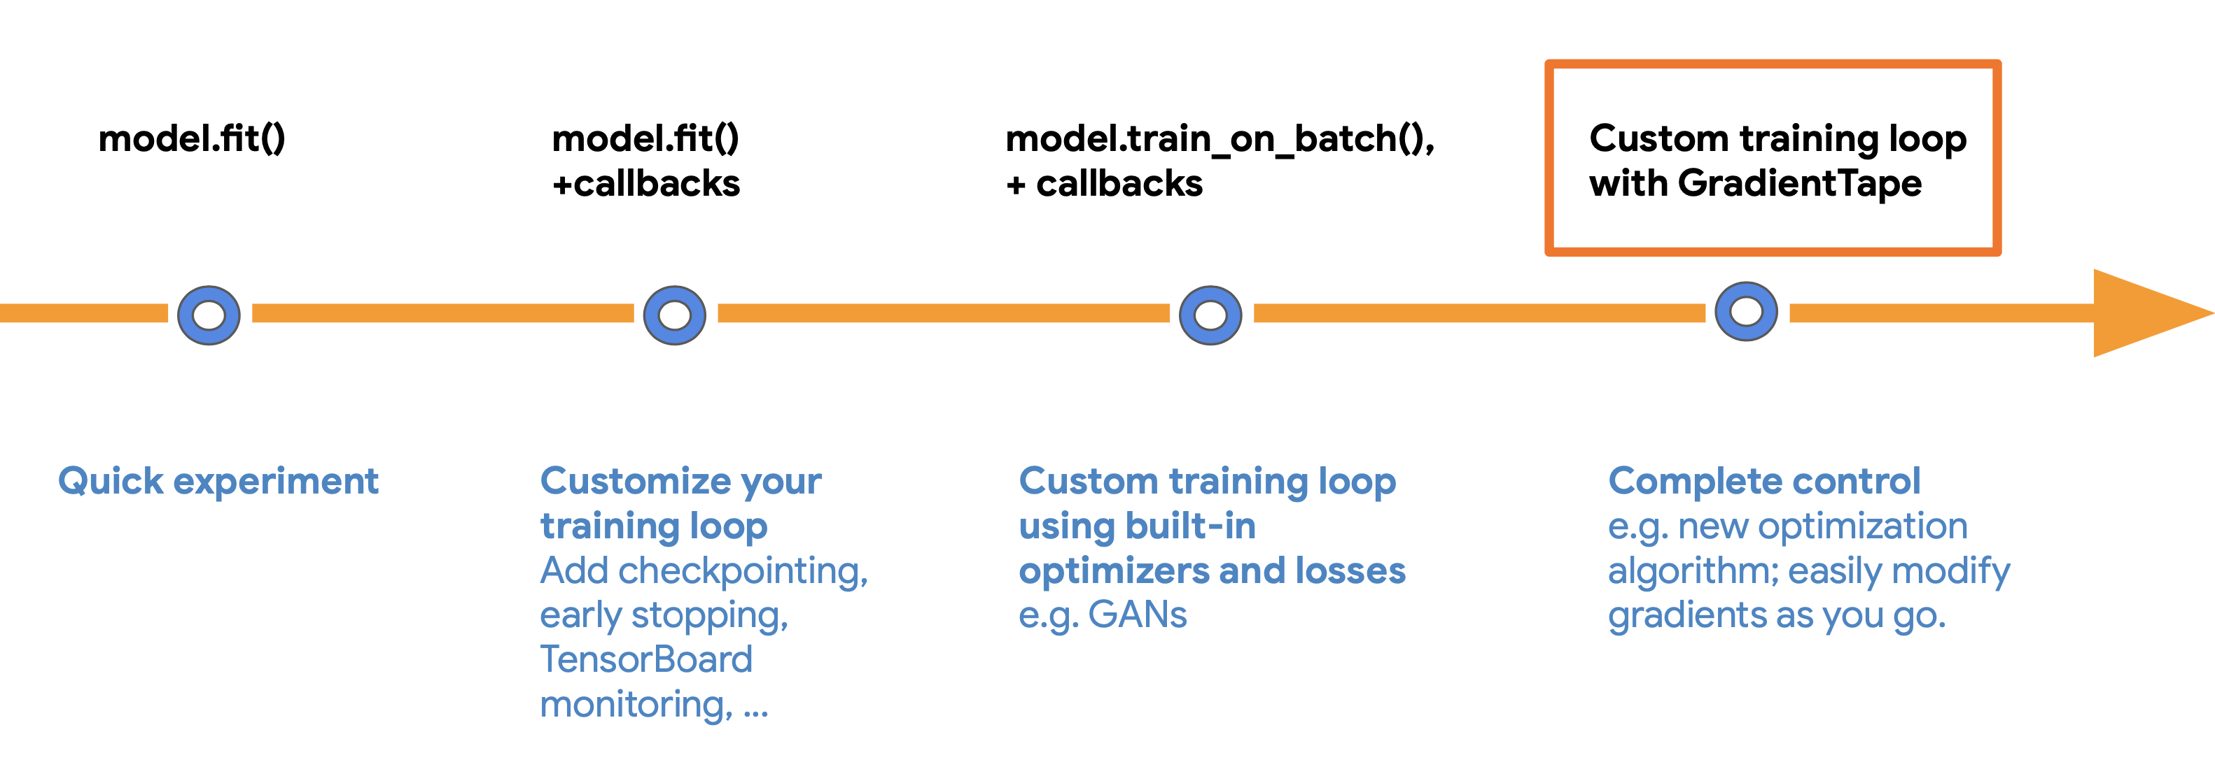
Model Training
Progressive disclosure of complexity

Slide 100
Model Training
Progressive disclosure of complexity

Slide 101
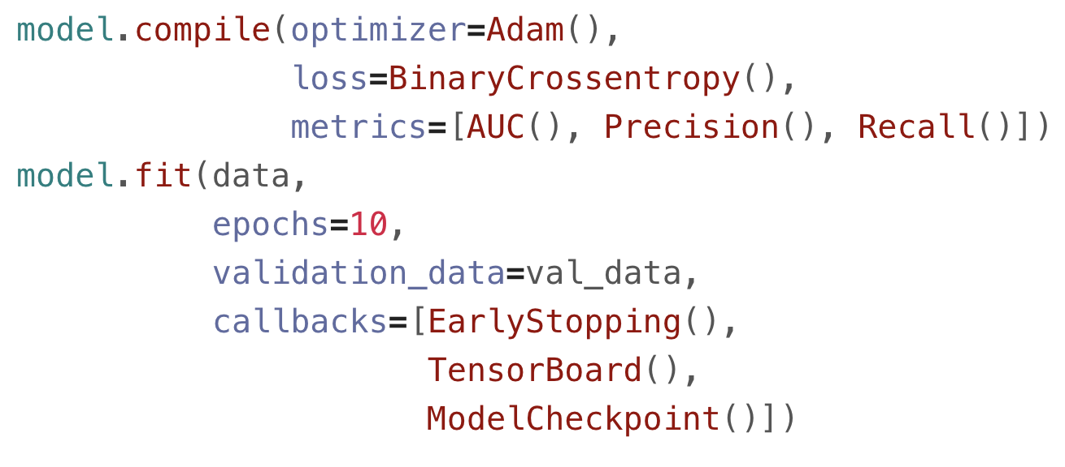
Model Training
model.fit() + callbacks

Slide 102
Model Training
Progressive disclosure of complexity

Slide 103
Model Training
Progressive disclosure of complexity

Slide 104
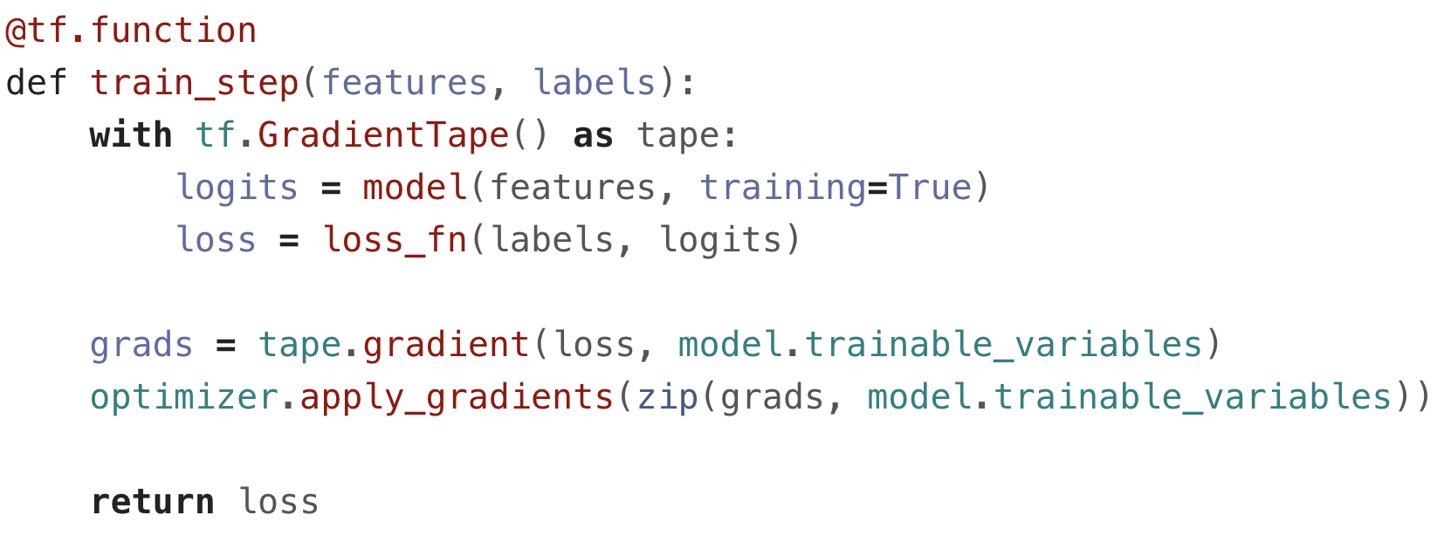
Model Training
Custom Training Loop with GradientTape

